Slide 1
Advance Python
Vijayalakshmi G M

Slide 2
Python OOP
Module in python
Exception Handling
Collections
File Handling
Regular Expression
DB Programming in Python

Slide 3
Module in Python
Module – contains set of functions and classes.
Functions are grouped into module based on its functionality.
Similar to header file in C or packages in Java
Modules are used to down large programs into small manageable and organized files.
Types
Built-in Module
User defined Module
import statement is used to add the module to our current program.

Slide 4
Exception Handling in Python
Run time error which occurs during the program execution.
Exception handling model keywords.
try
except
finally
raise
else

Slide 5
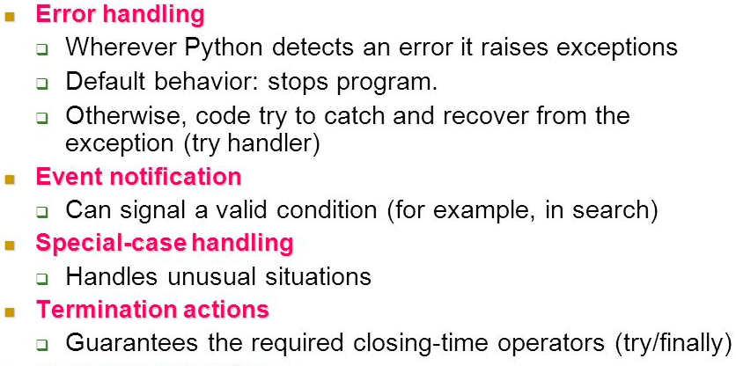
Exception Rules

Slide 6
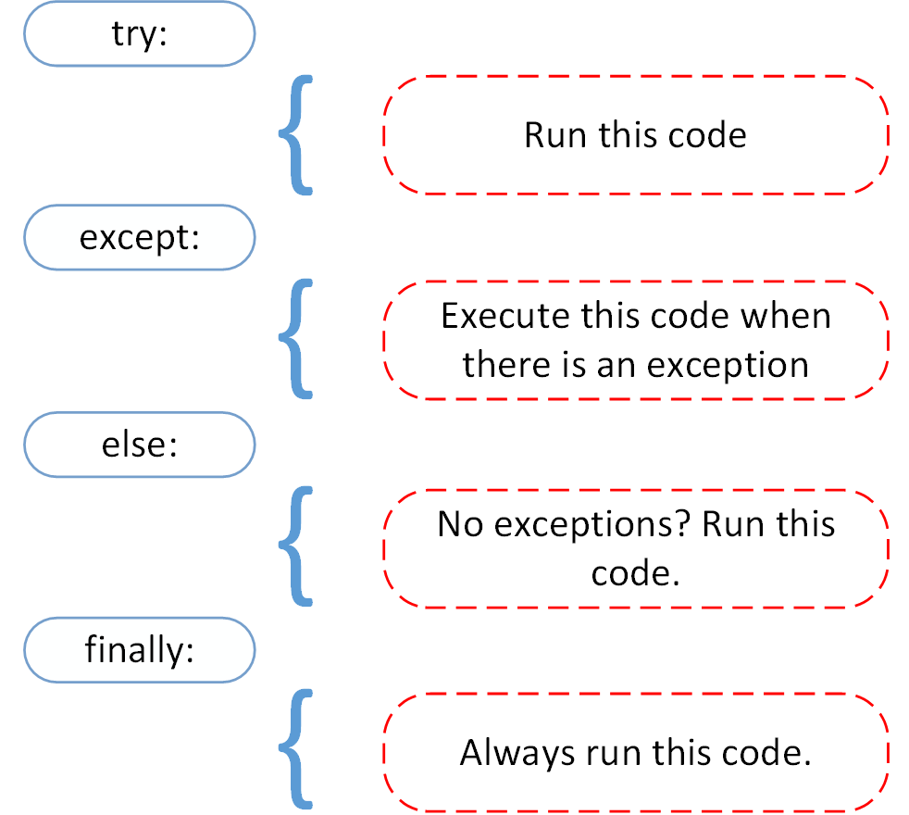
Python Exception Handling model

Slide 7
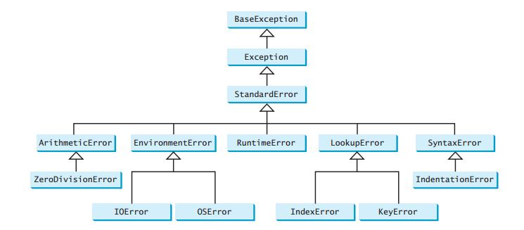
Exception class Hierarchy

Slide 8
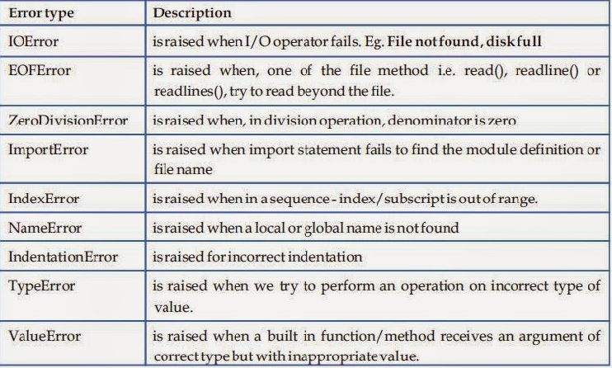
Exception class Hierarchy

Slide 9
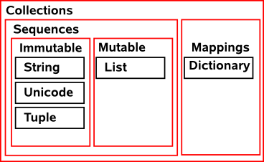
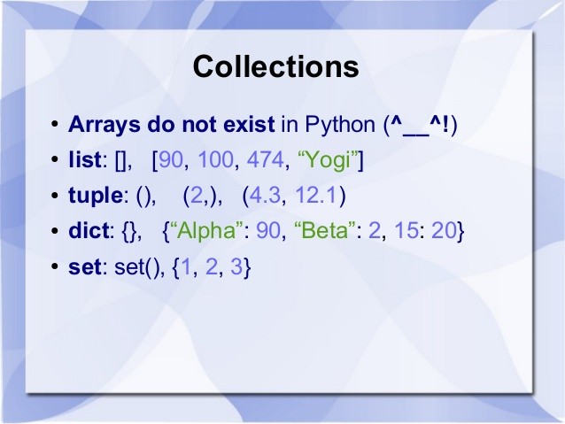
Collections in Python
Group of value or items stored with a single name

Slide 10
Python - List
Values/Items/Elements are enclosed in [ ] brackets.
Elements can be int, float, bool, String or List
Operations on the List
Finding the No. of Items
len() function is used to find the no. of items.
Adding the New Item
append() – Item will be added at the End of the List.
insert() – Item will be added at the specific Position
extend() – item will be added at the end. [String will be split to Individual character and List will be split into Individual item].

Slide 11
Python - List
Deleting an Item
del() – Item will be deleted based on the index position in the List.
remove() – Named item will be deleted.
pop() – removes the last item from the list
Searching an Item
in and not in keywords are used to search for a specific item.
Index() function is used to search for the item based on position.

Slide 12
Python - Tuple
Values/Items/Elements are enclosed in ( ) brackets.
Elements can be int, float, bool, String or List.
Tuple is read-only.

Slide 13
Python - Dictionary
Items are stored in Key/Value format and {} brackets are used to create dictionary.
Keys are Unique and Values can be duplicated.
Value will be accessed based on the Keys.
List can added as Dictionary item.

Slide 14
Python Set
Set items are enclosed in a {} brackets
Contains int, float, string, bool and tuple as its item.
It can’t contain
Duplicate items
Mutable items like List
Adding Item to set
add() – add the single item to the set.
update() – Multiple items to the set

Slide 15
Python Set
Removing Item from the set
discard() –position.
remove() –item name.
pop()- removes the last item.
clear() – removes all the item from the set.

Slide 16
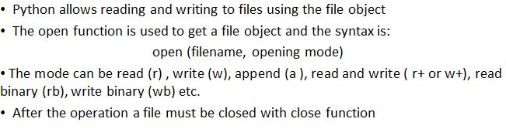
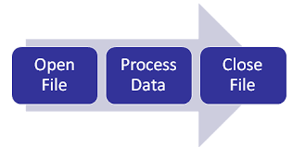
Python – File Handling

Slide 17
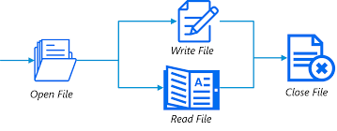

Python – File Handling
Open() Function

Slide 18
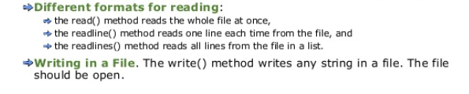
Python – File Handling
read() and write() function

Slide 19
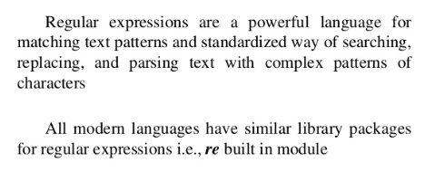
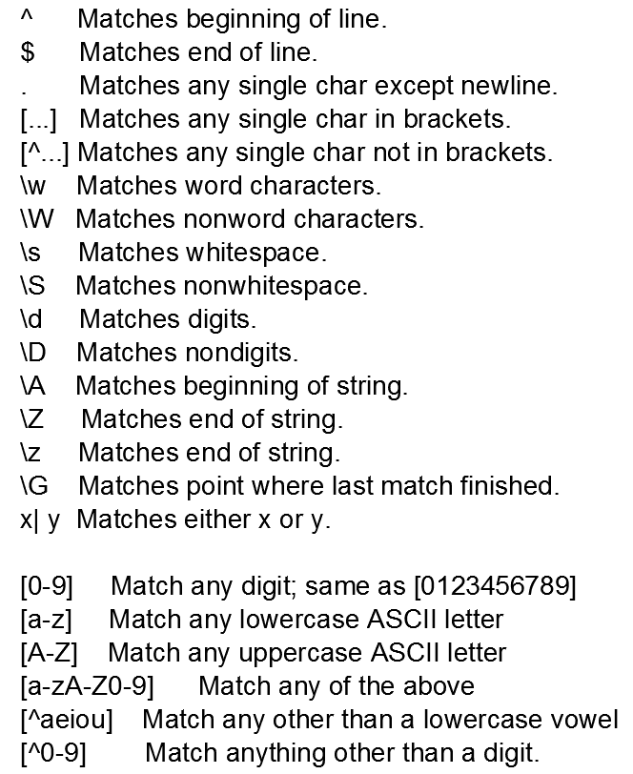
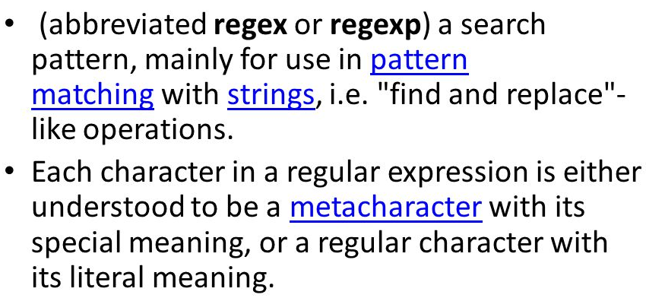
Regular Expression in Python

Slide 20
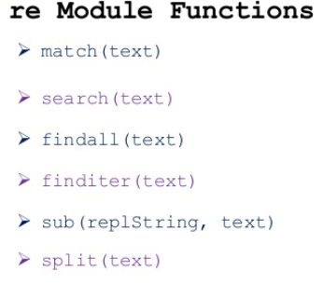
Regular Expression functions

Slide 21
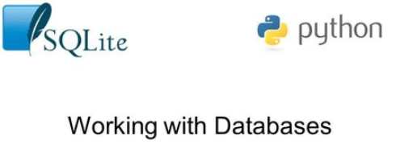

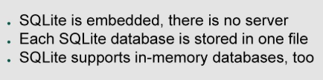
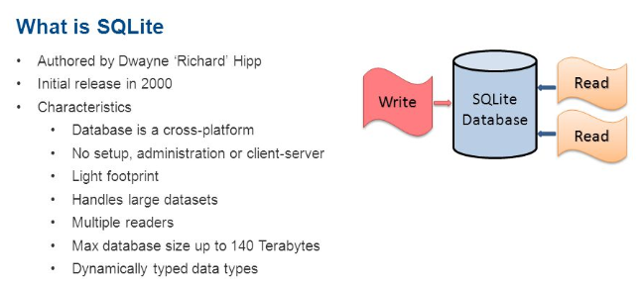
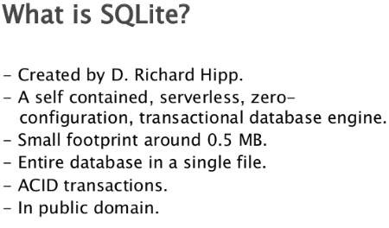
DB Programming in Python

Slide 22
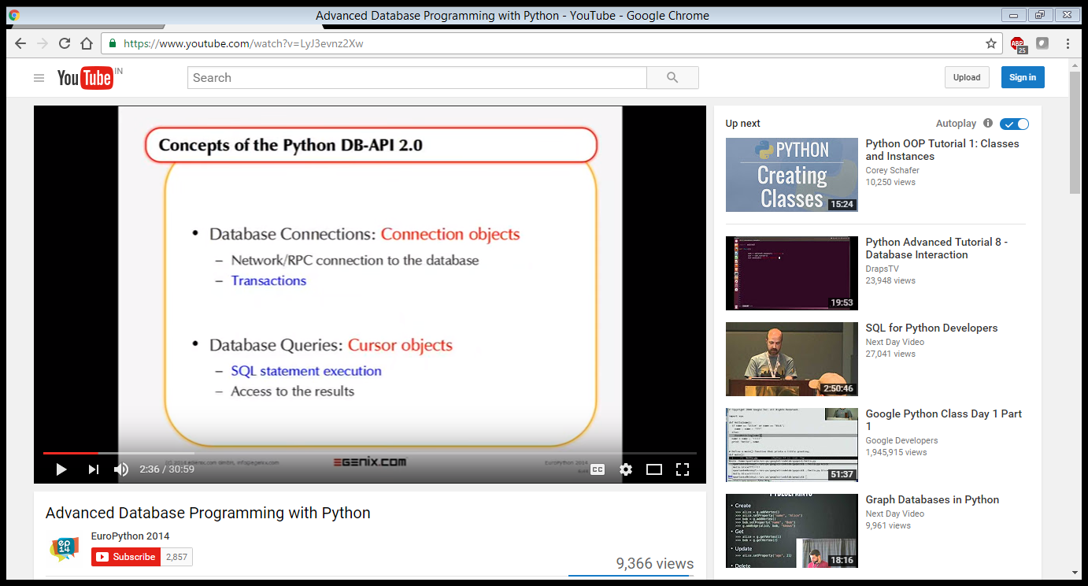
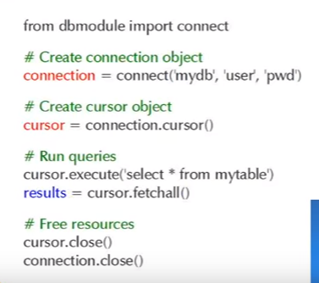
DB Programming in Python
Python have sqllite module which contains the function to interact with the sqllite Database.

Slide 23
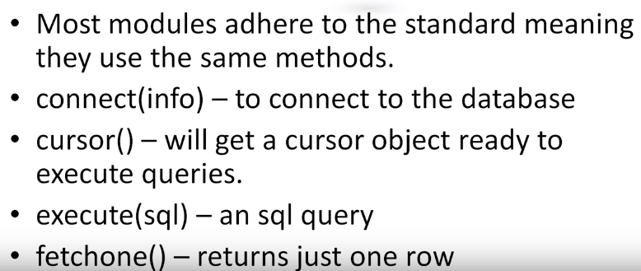
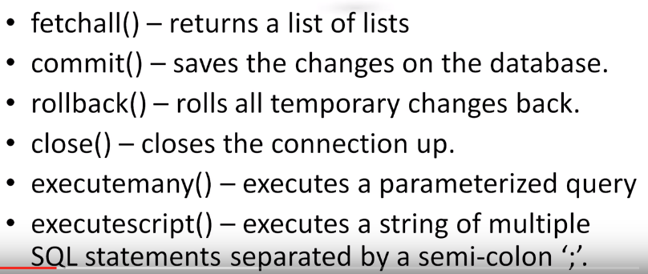
DB Programming in Python

